Slide 1
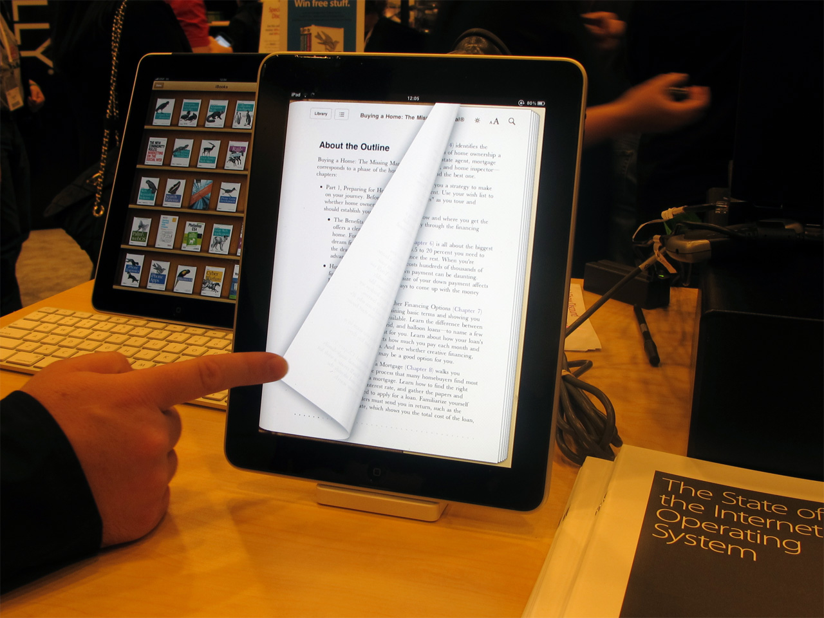
SOFTWARE PROJECT LAB-1 Smart library management based on INFORMATION RETREIVAL
Name: ABDULLAH AL MOMIN Supervisor Name:
Roll:BSSE1212 ABDUS SATTER RIFAT

Slide 2
Importance of online library system
1
It saves human efforts and time
Increase efficiency
Easy to access in Library Database
Users get 24/7 access to library
Makes the library a smart one by organizing the book systemically

Slide 3
The BASIC features of this project
2
Both for Administrator & users
The welcome massage
Login
Store information(consist of statistical measurement)
View book list
Searching details information of a book consist of name author category
Reading a particular book
Which belongs to administrator
Add book
Delete book
User management

Slide 4
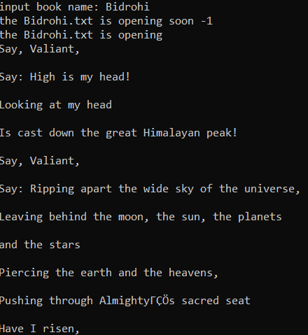
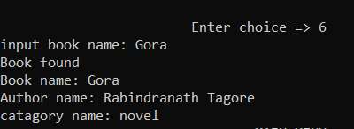
Progress so far……..
3
Based on input users can
See the book list from library database
Get details information of a specific book
Read a particular book online
Add book
Books
Book
info
Read

Slide 5

What’ll be done
4
Rest of the basic operation..
Login
Delete book
User management
RANKING BOOKS USING
INFORMATION RETREIVAL

Slide 6

The main purpose
5
Ranking books

Slide 7

6
How
it works?

Slide 8
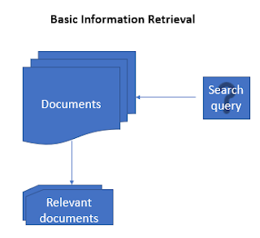
INFORMATIOM RETRiEVAL
7
Information retrieval(IR) refers to the process ,methods and procedures of searching, locating and retrieving recorded data and information from files or database.

Slide 9
8
Two powerful IR method
Bag of words
Cosine similarity
To store data from files or database
To compare & ranking

Slide 10
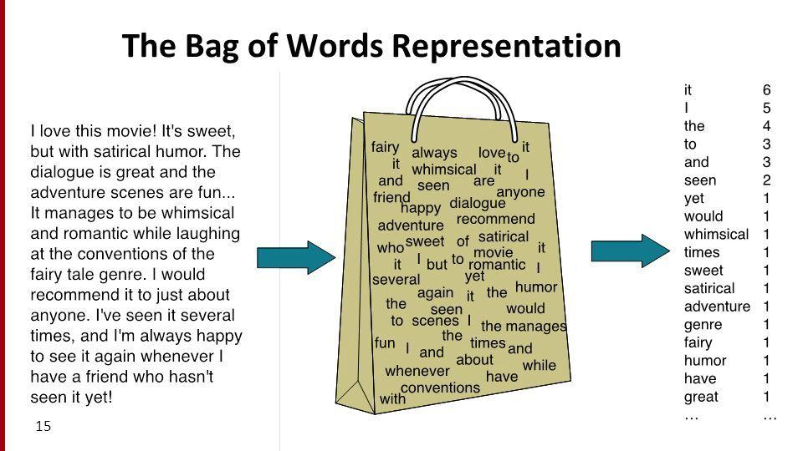
Bag of words
9

Slide 11
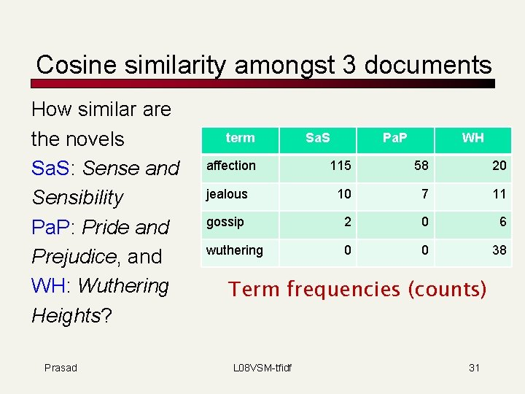
Cosine similarity
10

Slide 12
Required study
Statistical measurement
Vector set map
Linear regration among variables
Bag of words algorithm
Cosine similarity algorithm
TOOLS
Language:C/C++
Code-Blocks

Slide 13


Slide 14

https://github.com/BSSE1212/SPL-1

